Slide 1


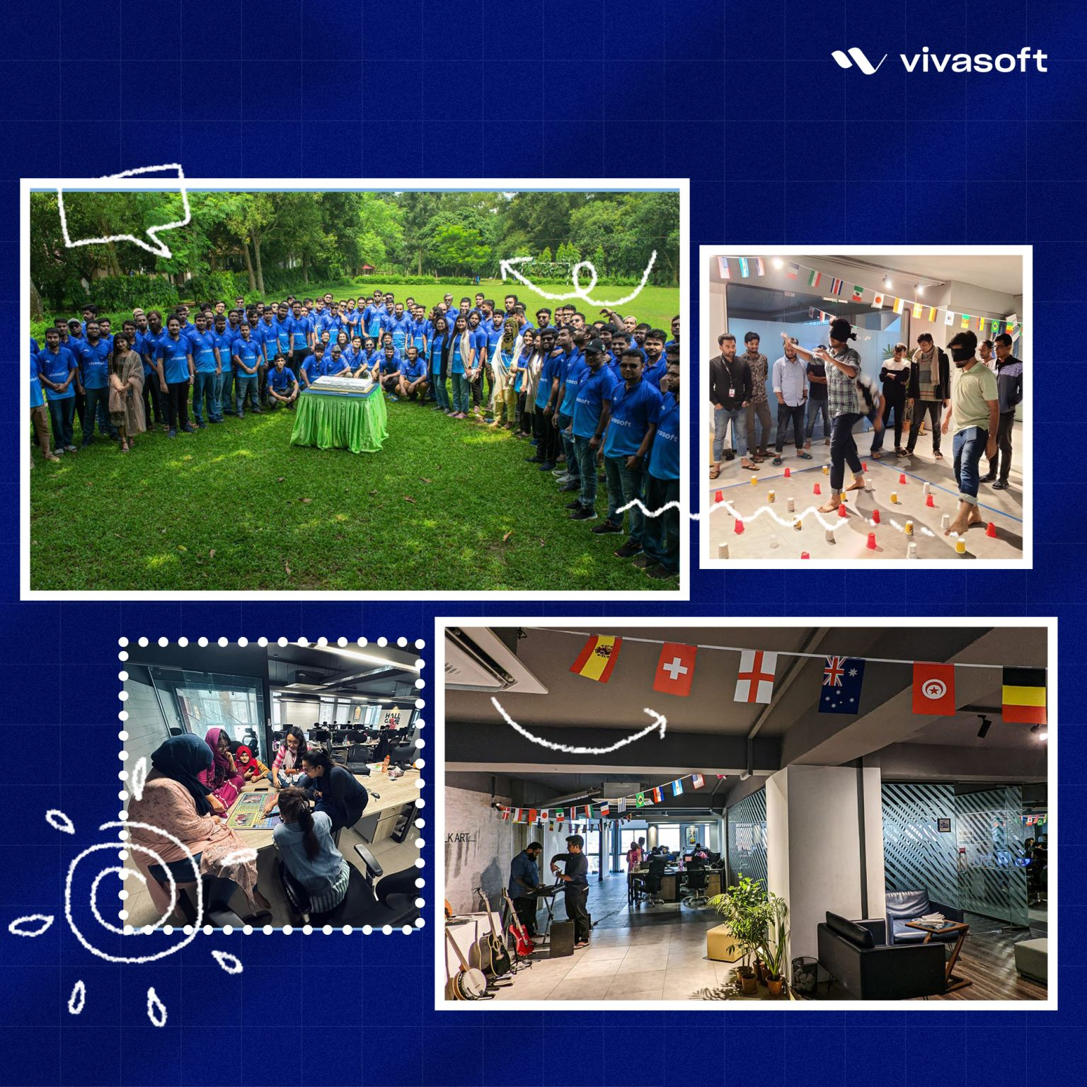
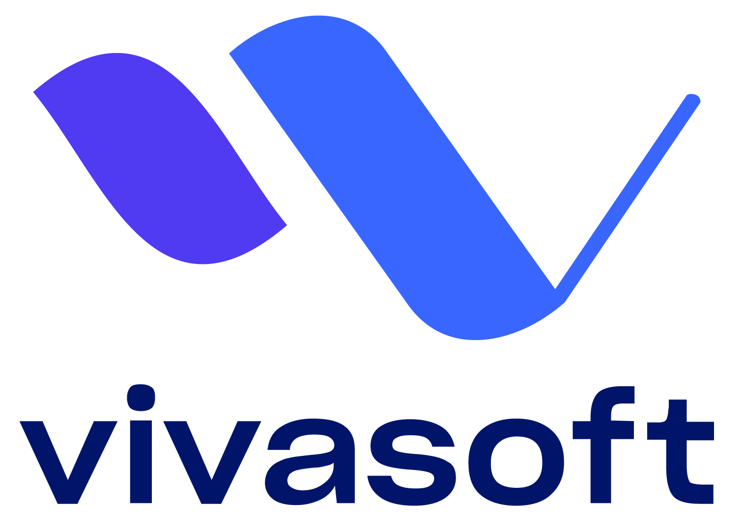
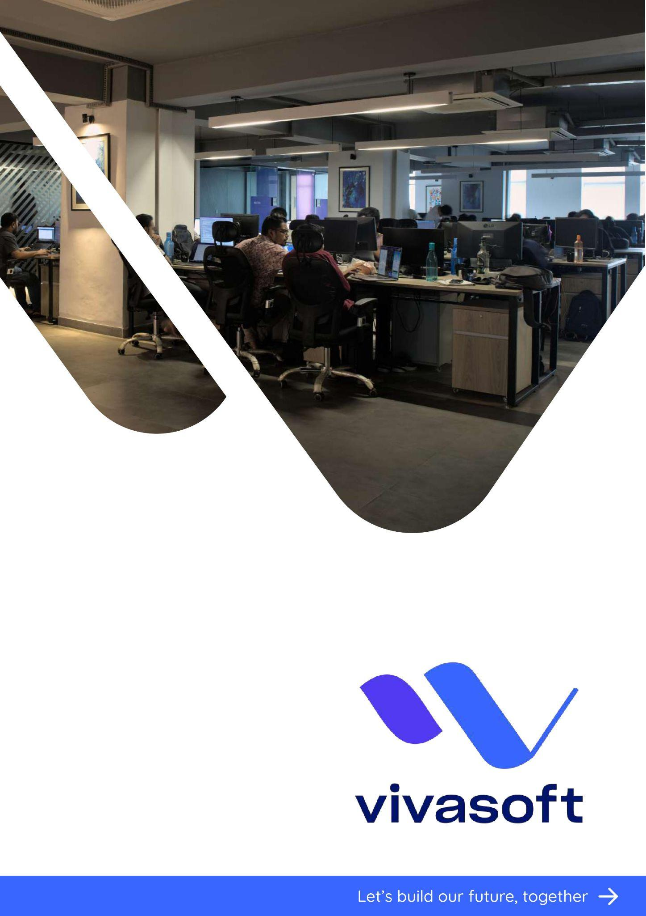
Internship at

Slide 3

About
Started Journey
Established in 2016
Co-founders were former front-line software experts
Overview
One of the fastest growing tech startup in Bangladesh with a healthy working Environment.
Employs around 200 professionals
Motto: Let’s Build Our Future Together.

Slide 4

Roadmap
Internship Plan of Vivasoft
01
Vivasoft designed a roadmap for interns and fresh graduates
Courses and Bootcamps
02
They have also created bootcamps for various technologies
Healthy Learning Environment
03
Vivasoft ensures dedicated mentor for every interns and fresh graduates

Slide 5

Assigned to Backend Team at Klikit
Focused on GoLang as Backend Language
Guided by Two Dedicated Mentors
Emphasis on Learning Core Backend Concepts
Starting of our Journey

Slide 6
Overview of Internship
Internship Period
Initial Learning Phase
Live Project Involvement
Open Source Contribution (GoLang Bootcamp)
Exploring Kafka and RabbitMQ
Live Projects-1
(Pi-inventory)
Exploring DevOps Basics
Gaining Insights into Diverse Projects and Architectures
Demo Projects-1
(Librario)
Demo Projects-2
(e-Shopify)

Slide 7
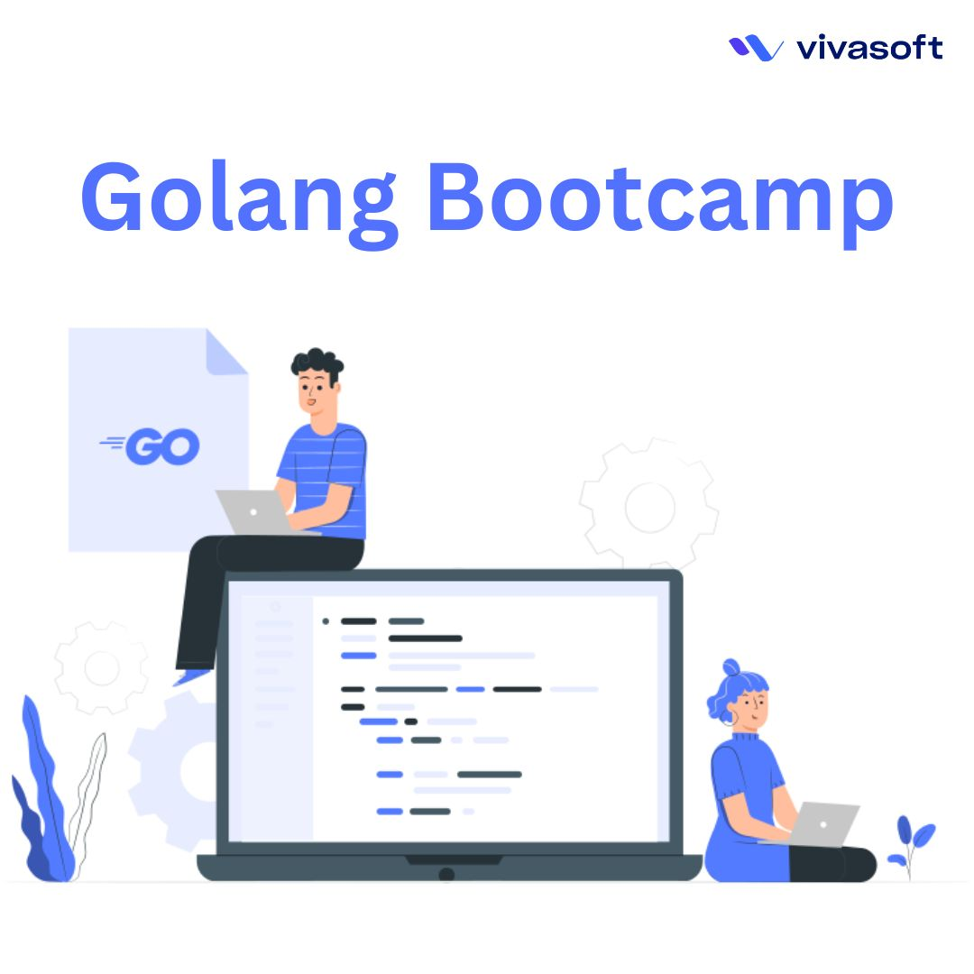
Writing GoLang Bootcamp in Bangla Language
Authored Chapters Covering Vital GoLang Concepts and practice problems
Acknowledged the Power of Documentation and Open-Source Culture
Bridged Language Barrier through Writing in Bengali
Positive Impact on Aspiring Developers' Growth

Slide 8

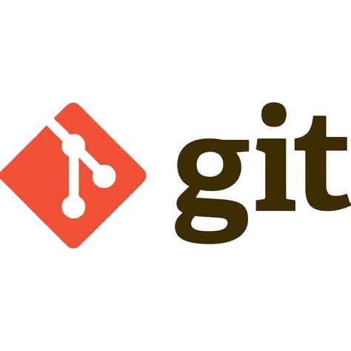
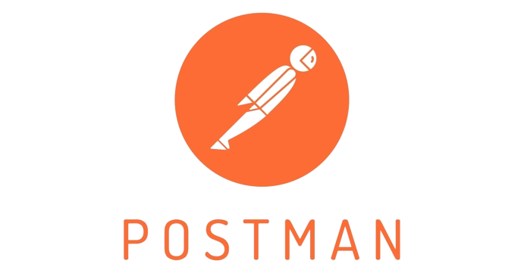
Librario (Demo Project-1)
Initial Learning Phase
A robust backend for a BookStore application
RESTful APIs
Clean Architecture (Repository Pattern)
Data validation and error handling.
Best practices for optimizing performance and maintainability.
Tools and Technologies Used in the Project:

Slide 9
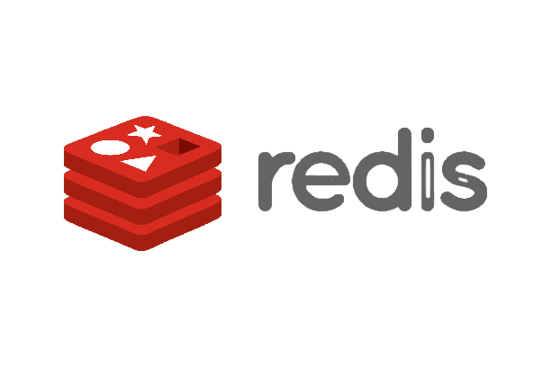



e-Shopify (Demo Project-2)
Initial Learning Phase
A backend for an e-commerce application
RESTful APIs using Echo framework
User Authentication & Authorization
Redis as a caching mechanism
JWT (JSON Web Tokens)
Dockerized the backend application
Tools and Technologies Used in the Project:

Slide 10
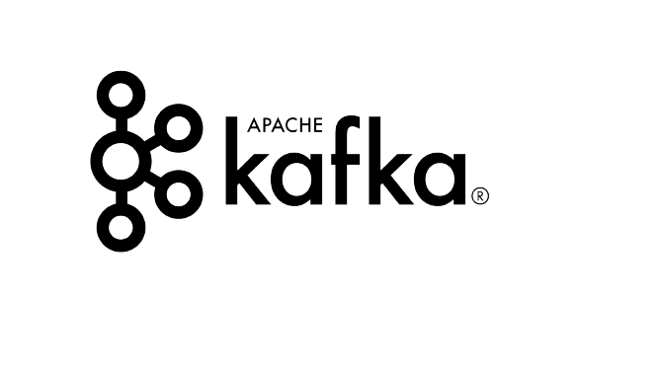
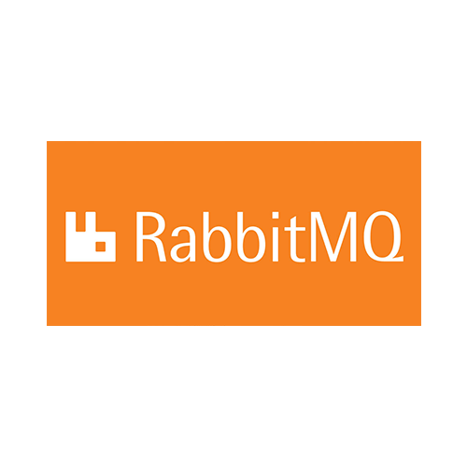
Initial Learning Phase
Exploring Kafka and RabbitMQ
Core concepts and functionalities of message queues
Proof-of-concept projects using Golang
Benefits of message queues
ensuring fault tolerance,
decoupling services
managing message processing asynchronously

Slide 11
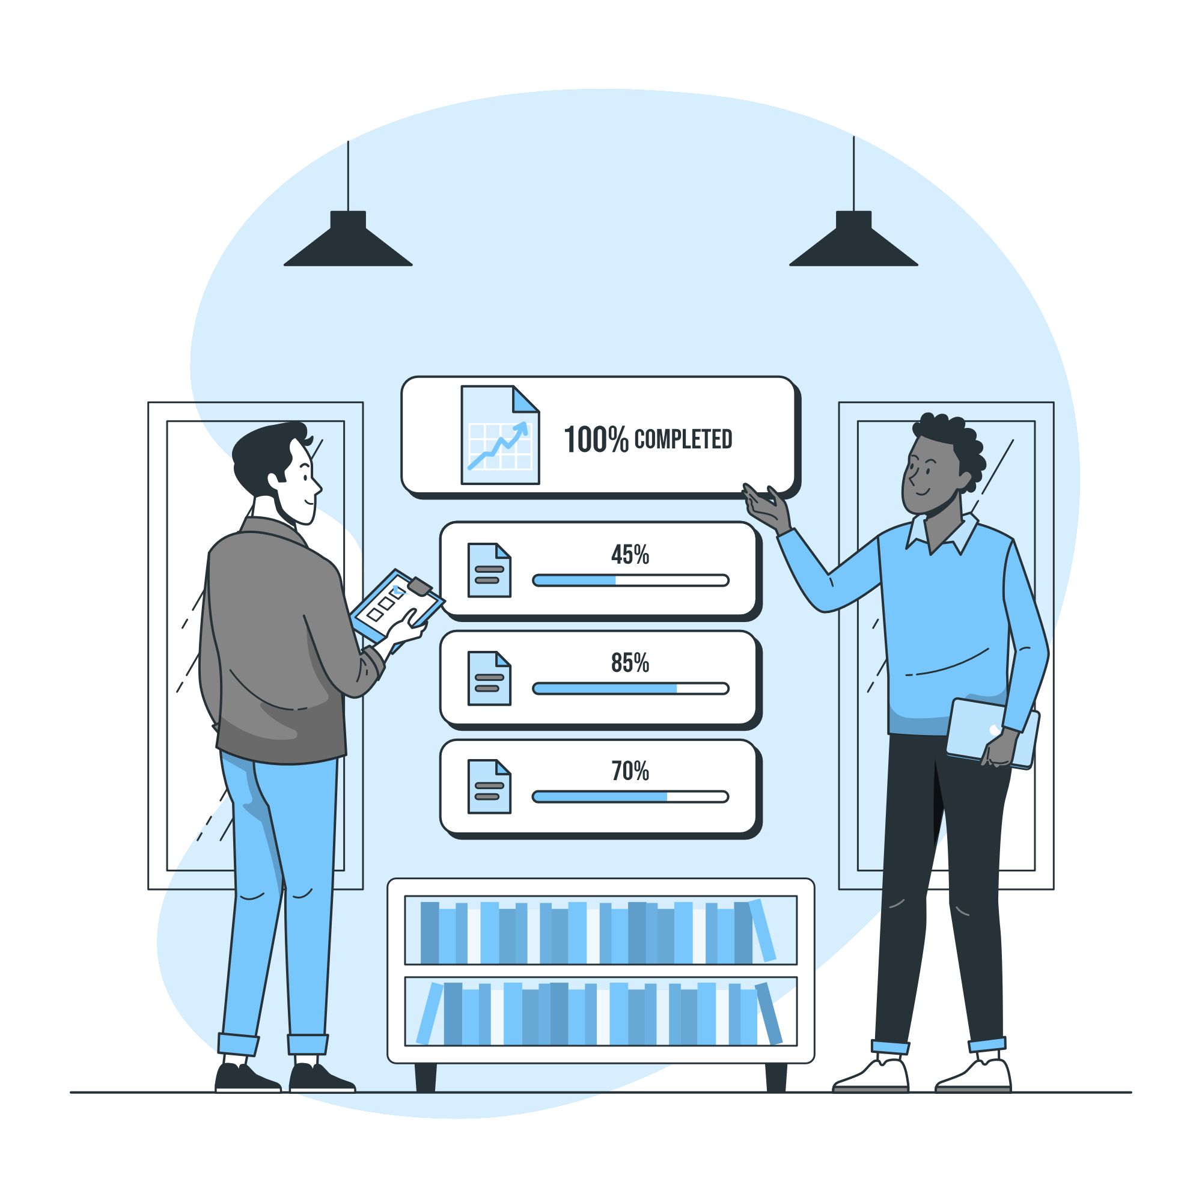
Live Project Involvement
Pi-Inventory
An Inventory tracking system
Designed and built as a service of Financify
Has a potential to be a solo product in future
Main features
Stock Creation
Stock Adjustment via invoice from Financify
Alert via Notification for low stocks
Report and Summary of stocks
Stock Adjustment history

Slide 12
Responsibilities
Contributed in Database design and
shaping the overall business flow of the system.
Developed RESTful APIs in Golang using the Gin framework.
Coded for easy future implementation of transaction and rollback mechanisms
Used Redis as a caching mechanism to optimize application performance
Implemented Pagination for handling large datasets.
Collaborated with SQA and Frontend teams to identify and resolve bugs.
Refactored codebase for API Integration with Financify
Participated in meetings, gathered backend requirements.

Slide 13



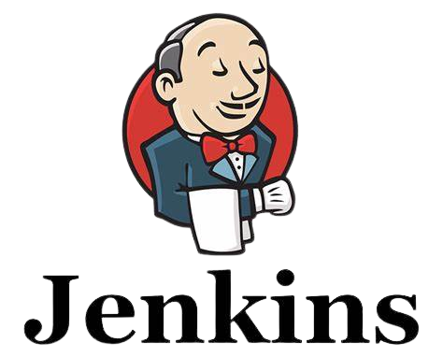
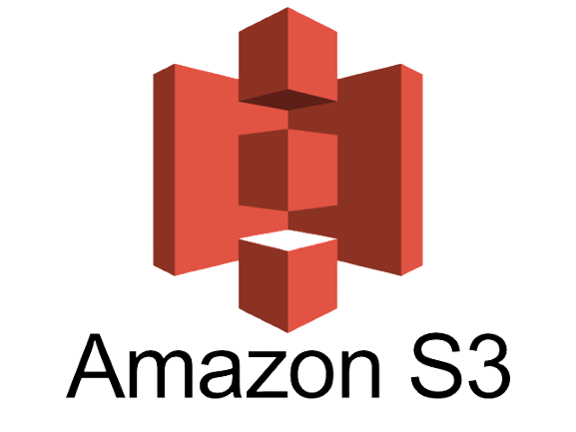
Tools and Technologies Used in the Project:
GoLang
Used as Backend Language
Gin
Framework Used for
fast development
Used As Relational Database
Used for Caching
Used for Version Control
Used for API documentation & Testing
Used for Authentication
Used for Containerization
Used as Cloud storage
Used as Continuous integration tool

Slide 14
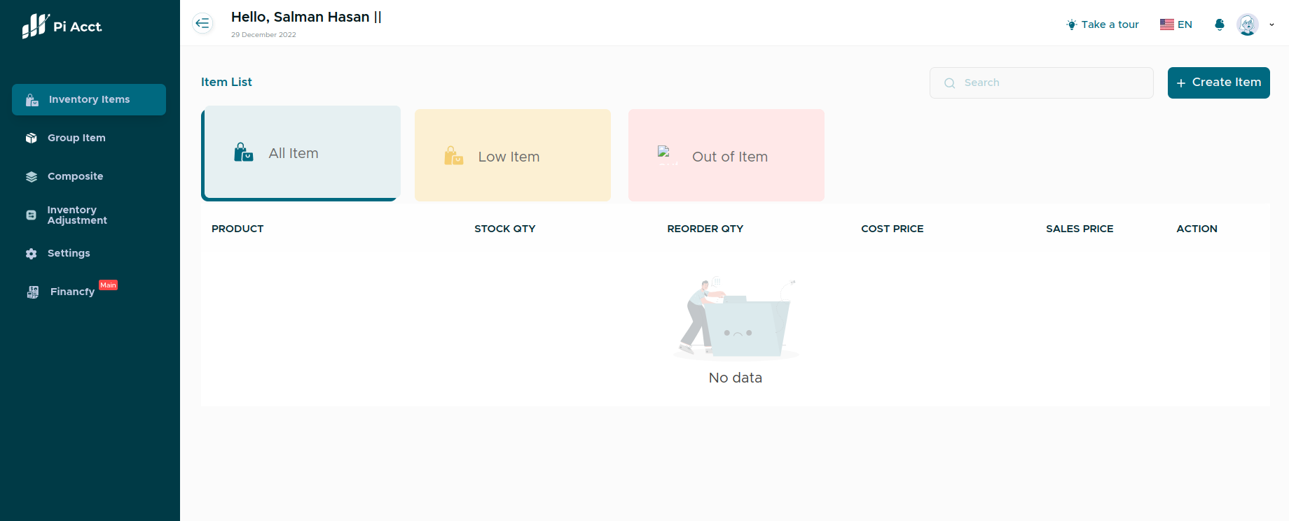
Figure: Pi-Inventory Dashboard

Slide 15
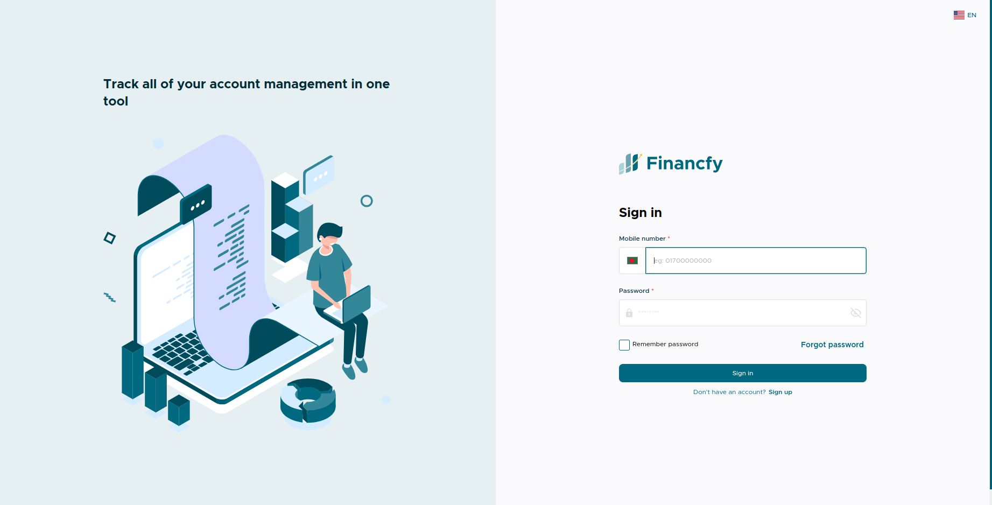
Figure: Financify Login Page

Slide 16
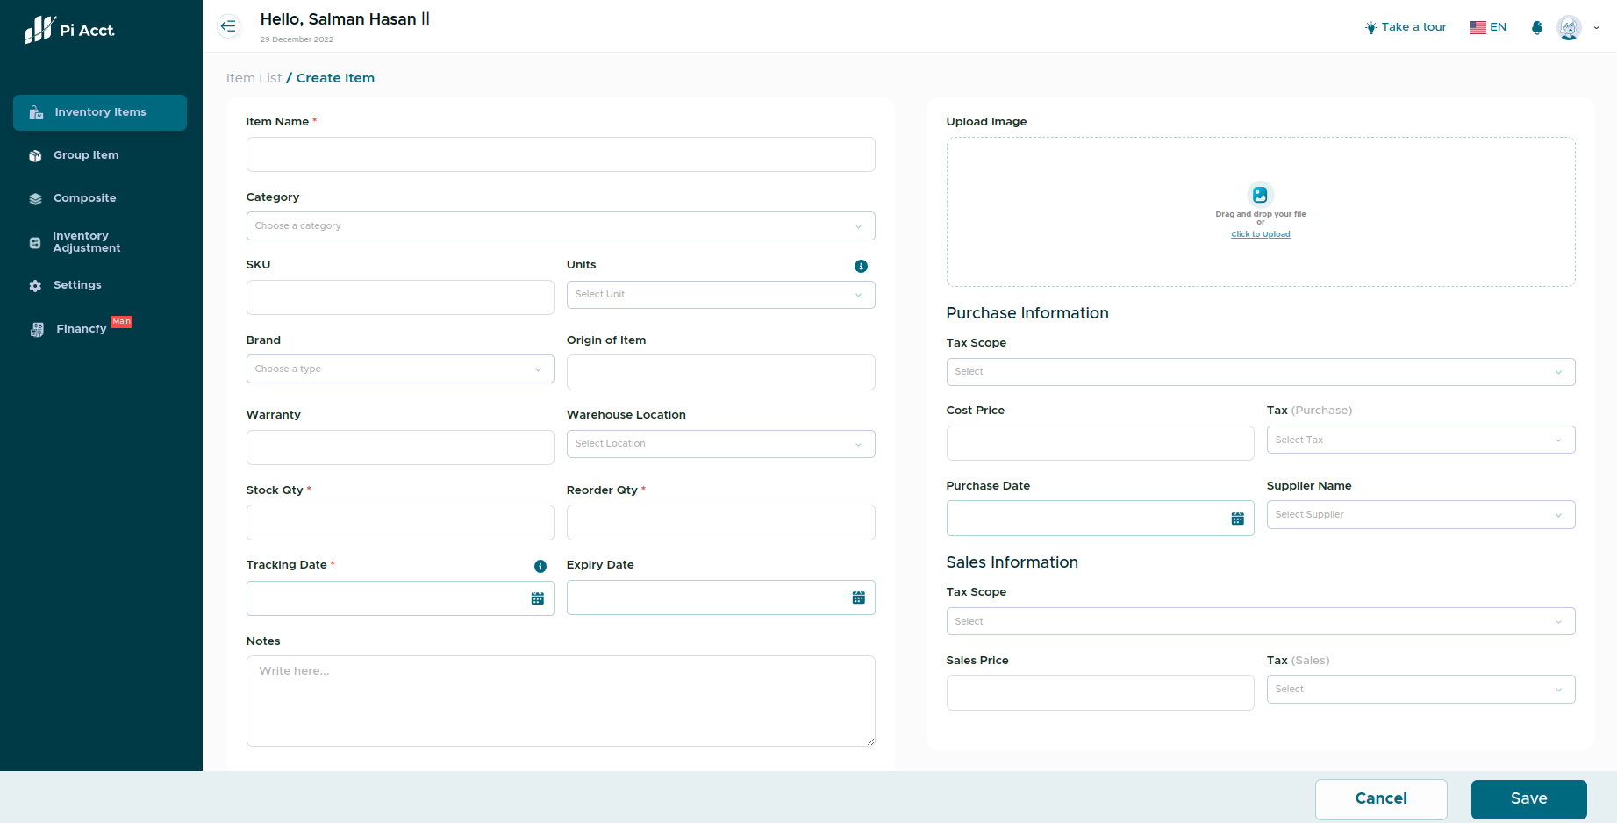
Figure: Create Item Page

Slide 17
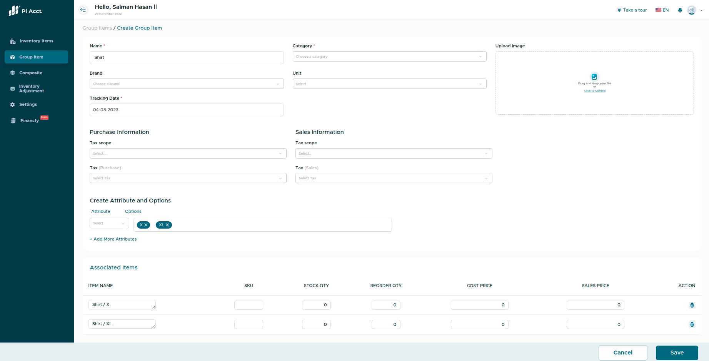
Figure: Group Item Create Page

Slide 18
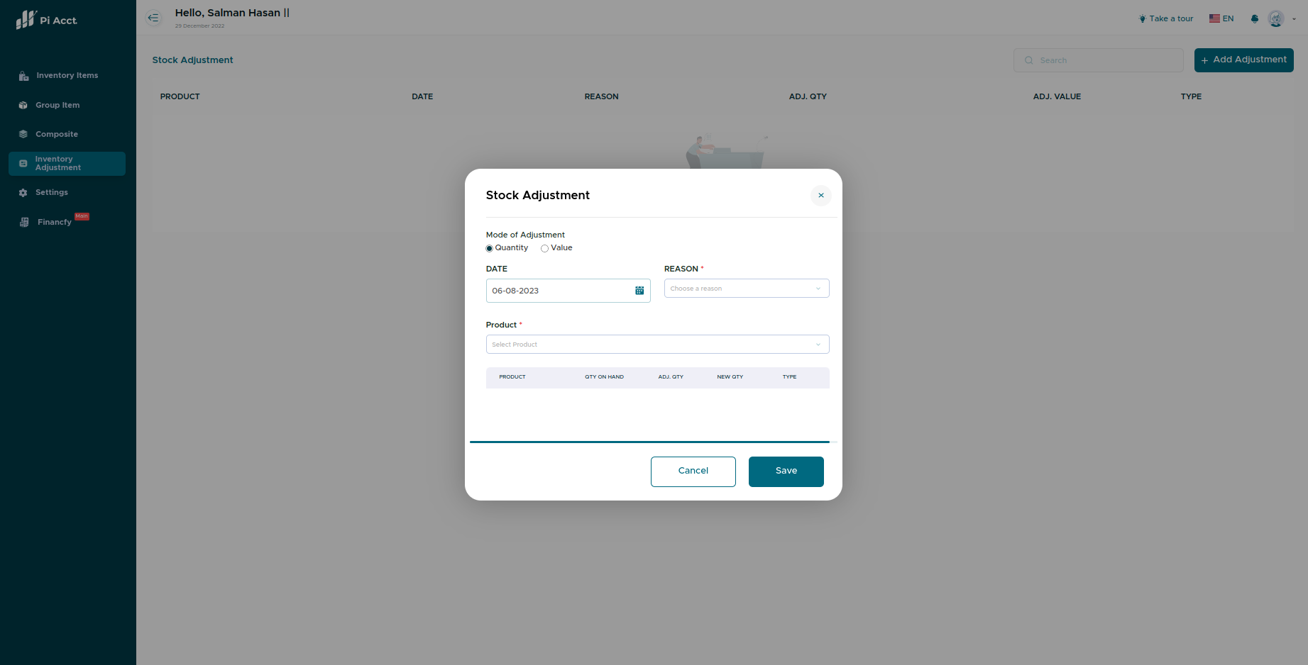
Figure: Stock Adjustment Page

Slide 19
Gaining Insights into Diverse Projects and Architectures
Gained insights about the
Project Structure,
Microservice Architecture,
Control flow,
load-balancing mechanisms,
Api-Gateway,
of projects within the organization, including the GPS-Tracker and CRUD Generator projects.

Slide 20
Exploring DevOps Basics and Cloud Services
Gained a broader perspective software development lifecycle and collaboration between development and operations teams.
Delved into the world of cloud services, primarily focusing on Amazon Web Services (AWS), and explored essential AWS services such as Amazon EC2 for scalable computing and Amazon S3 for object storage.

Slide 21
Tools and Technologies I Learned:
GoLang
Used as Backend Language
Gin
Frameworks Used for
fast development
Used for Caching
Used As Relational Database
Used for API documentation & Testing
Used for Authentication
Used for Containerization
Used for Version Control

Slide 22
Personal Improvement
Technical
Skills
Non-
Technical
Skills
Personal
Growth
Professionalism
Knowledge
Sharing
Tools & Framework
Version Control Management
Communication
Punctuality
Documentation
Code Review
& Refactoring
Planning
No Blaming
Containerization
Microservice Architecture
How is this working under the hood?

Slide 23
Thank You!

